Slide 1
Revising-Editing-Proofreading

Slide 2
Revising an Essay for Coherence
Editing for clarity, coherence and unity.
Clarity means writing clearly so that the reader understands you.

Slide 3
Defining coherence
The coherence of a paper refers to how well the paper is organized and how well the ideas and details in each paragraph fit together and flow.

Slide 4
Hints for Effective Proofreading
Read the document aloud,
proofread as many times as possible
(many errors slip through in the first reading)
select only one feature of writing to check in each proofread (E.g Coherence,
Get others to proofread your
Make sure you’ve ticked off all the boxes in the Editing/Proofreading Checklist.

Slide 5
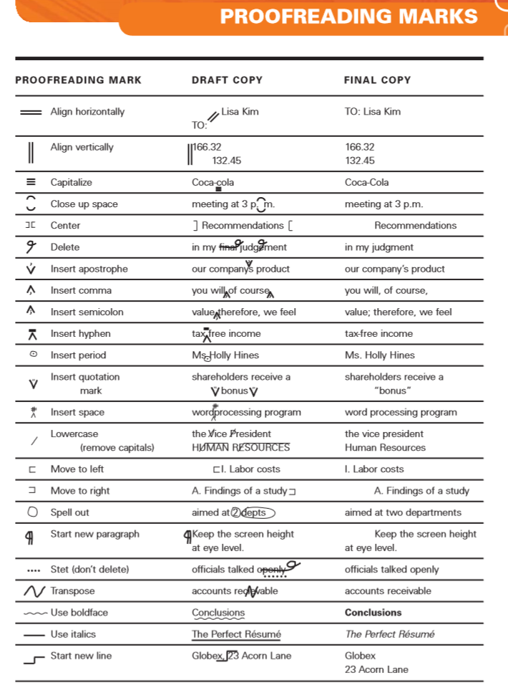

Slide 6
Editing/Proof-Reading Checklist

Slide 7
Content [What the document says]
Is the essay title appropriate for the topic and content?
Is all material included accurate, relevant, and up-to-date?
Have you used technical terminologies correctly?
Have you given sufficient definition, clarification, illustration, or examples of complex concepts?
Is your argument logically sound and supported by evidence?
Have you appropriately acknowledged your sources?
Have you omitted everything that is irrelevant?

Slide 8
Structure - How the Content is Organized
Does every paragraph have clear topic and wrap sentences?
Are the main points easily identifiable to the reader?
Are paragraphs adequately developed to support main points?
Are there too many ideas in any paragraph?
Is there a new paragraph every time there is a shift in topic?
Are there adequate transition markers between paragraphs?
Does the introduction adequately prepare the reader for the middle paragraphs?
Does the conclusion draw together the main points?

Slide 9
Mechanics writing conventions
To check whether the grammar is correct, see if:
Sentence subject and verb agree, pronouns and antecedent nouns agree
There are no ambiguous pronouns
Parallel construction are correctly used and there are no misrelated modifiers
Prepositions and articles are correct
Verb tenses are correct and consistent

Slide 10
Mechanics writing conventions
Is your punctuation correct? Check that:
Commas serve correct structural function
There are no comma 'splices' or run-on sentences
Commas are correctly used with 'which' and 'who‘
Apostrophes are used to indicate possession, not plurals,
Colons (:) and semi-colons (;) are correctly used, quotation marks (') or (") are used consistently.

Slide 11
Mechanics writing conventions
Is spelling correct?
Is capitalization correct?
Does the syntax (word order) follow English conventions?

